Slide 1
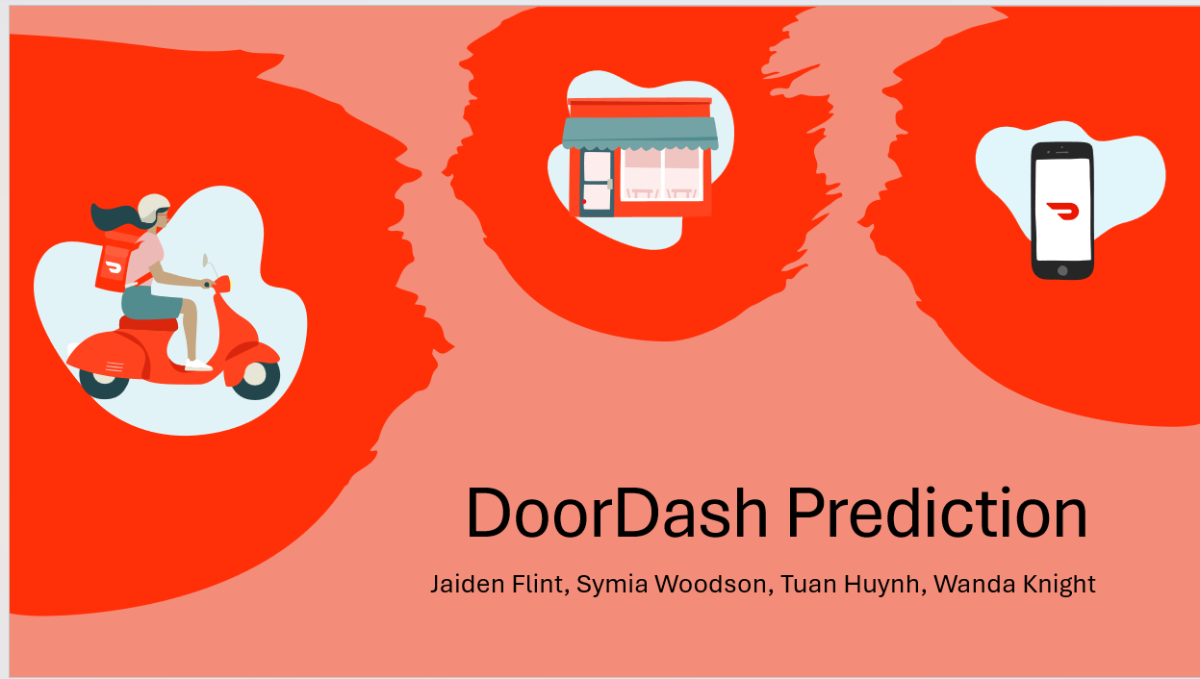
DoorDash Prediction
Jaiden Flint, Sy Woodson, Tuan Huynh, Wanda Knight

Slide 2
Executive Summary
Examined the profitability and stock share value of DoorDash
Gathered vital information about the company’s growth and their future growth
Reviewed DoorDashs financial statements and converted them into graphs
Transformed their financial information into easy-to-read documentation of their growth starting from 2022 up to 2024
Notes:
Examining the profitability and stock share value of DoorDash provided vital information about how much the company has grown and the direction they are headed in.
By taking the financial statements provided by DoorDash and converting them into graphs, we were able to transform the information into easy to read documentation of their growth starting from 2022 up until 2024.

Slide 3
Data collection, cleanup, and exploration
Various sources were used to collect data including:
-DoorDash Investor Relations (IR) website for financial data:
The IR website was easy to navigate
The data was easy to download as a pdf
-Yahoo Finance for the stock market data for the past two years:
Looking for correlation to investors reaction to the company’s profit and revenue
Yahoo Finance is a reliable source for stock reports
Notes:
Where the data came from :
DoorDash Revenue and Usage Statistics (2024) - Business of Apps
DoorDash Investor Relations https://ir.doordash.com/financials/sec-filings/default.aspx
source data reference for the stock data of DoorDash came from finance.yahoo.com.
More specifically from this this web address: https://finance.yahoo.com/quote/DASH/history/?period1=1640995200&period2=1712016000

Slide 4
Data collection, cleanup, and exploration Cont’d
Collection, exploration, and cleanup process:
Extracted data from various sources and forms then converted into csv files and then dataframes
Removed years and [samples] that had missing data
Explored possible future values based on the trends provided
Notes:
Where the data came from :
DoorDash Revenue and Usage Statistics (2024) - Business of Apps
source data reference for the stock data of DoorDash came from finance.yahoo.com.
More specifically from this this web address: https://finance.yahoo.com/quote/DASH/history/?period1=1640995200&period2=1712016000

Slide 5
The approach Group 3 took to achieve the project goals:
Compared the expected vs reality
Limited public data
Did not disclosure daily orders
API only for restaurants and delivery simulator
The public financial statements only went from 2022 through 2024 Q1, but still provided relevant data and we were able to make a prediction
Predicted the next second quarter for 2024, shortly after DoorDash 2024 Q2 report was released
Notes:
Sy
Include any relevant code or demonstrations of the application or analysis.
Discuss any unanticipated insights or problems that arose and how you resolved them.
Use Prophet

Slide 6
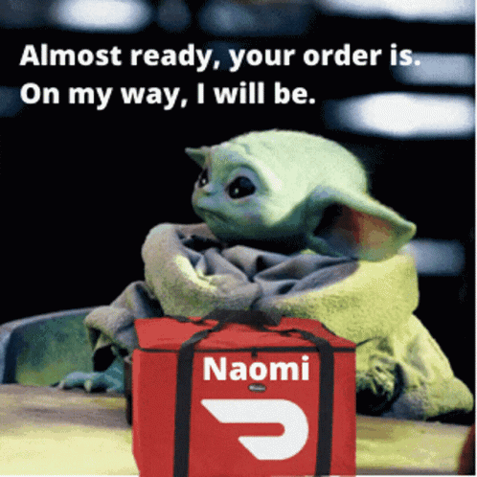
The results/conclusions of the application or analysis:
From the data assembled from DoorDash’s quarterly filings we were able to track over the years and predict the company’s trajectory based on market trends
Notes:
Sy
Include relevant images or examples to support your work.
If the project goal was not achieved, discuss the issues and how you attempted to resolve them.

Slide 7

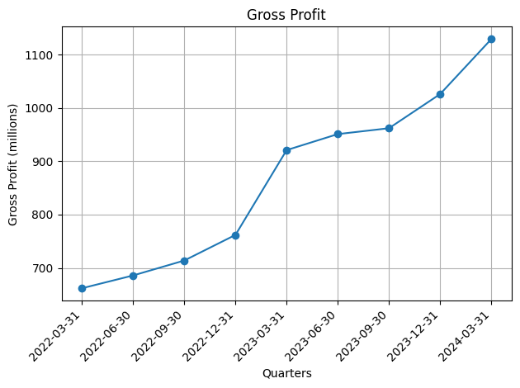

Gross profit had a slow trend upwards for the year 2022
2023 Q1, profits jumped because of improved business practices
Overall the gross profit has been an upward trend
Notes:
Sy
Gradual increase until Q1 of 2023 but mellows out

Slide 8
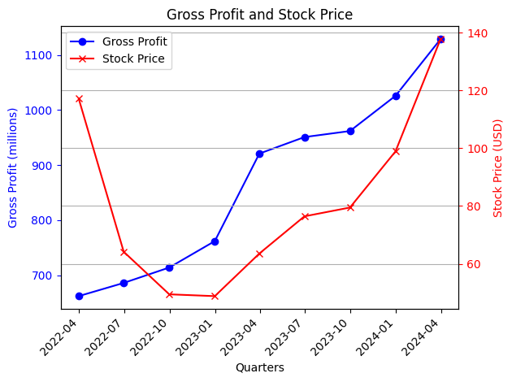
DoorDash stock prices suffered from 2022 to 2023 due to wider than normal losses for the business even though gross profits were climbing
After 2023, the stock prices and gross profits were following each other in an upward trend
Notes:
The color pink is the background color so that can be changed easily. The white splotch is two white pieces lined up. They can be moved because they are just images

Slide 9

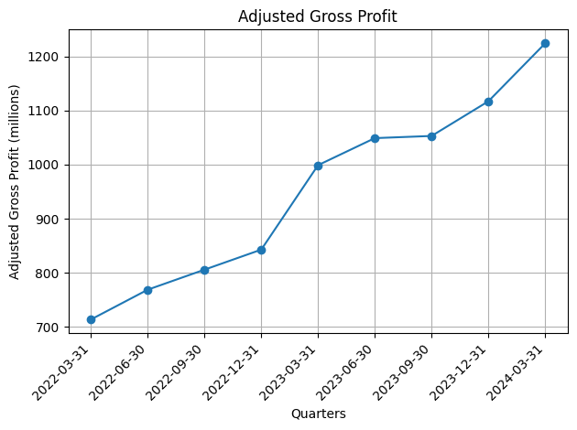

Adjusted gross profit data had a slow trend upwards for the year 2022
Q1 of 2023, profits jumped because of improved business practices
Overall the gross profit has been an upward trend
(This graph is similar to the non-adjusted and has taken account for other profit contributions in the company)

Slide 10
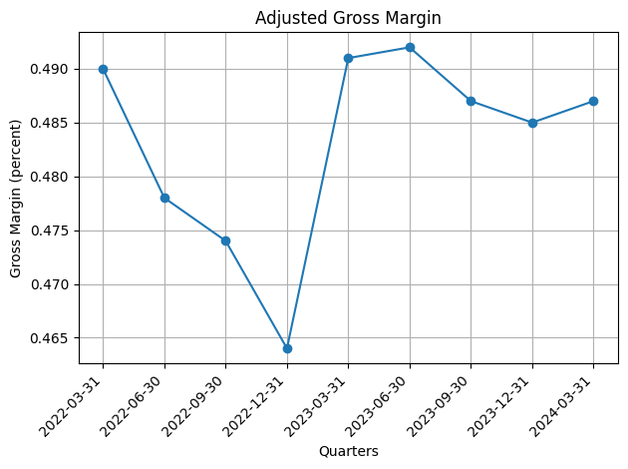
The gross margin in percent (%) ranges from about 46% to 50% for the years 2022 & 2023
The lowest percent gross margin occurred at the end of 2022
Then the percent gross margin climbed to 49% and stayed steady ever since

Slide 11

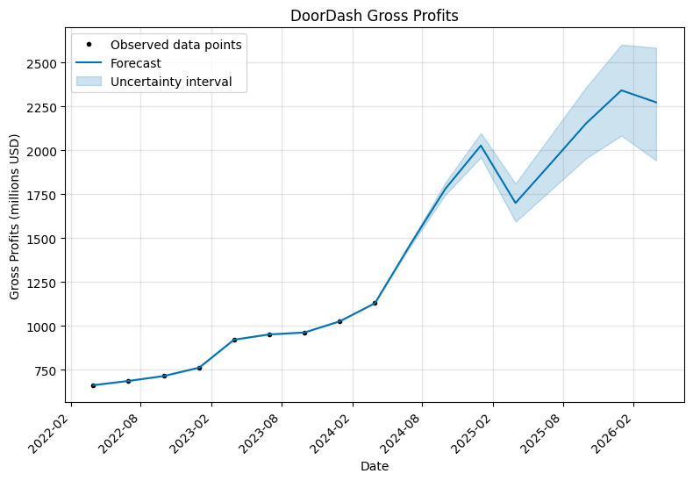
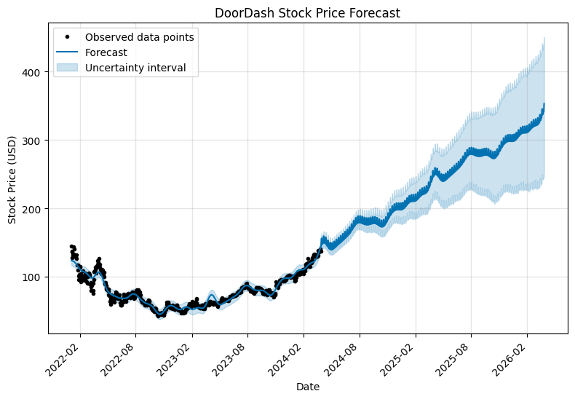
Future Forecast of Gross Profits and Stock Prices
Gross Profits & Stock Prices future forecast have an upward trend
Stocks have a wider uncertainty as time progresses
Gross Profits also have the same uncertainty but an intriguing dip
Notes:
Tuan: Using Prophet to predict the future data of the stock and gross profits.
The uncertainty intervals widen as the future forecast progresses. We were curious how these two financials would be like in the future based on past data

Slide 12

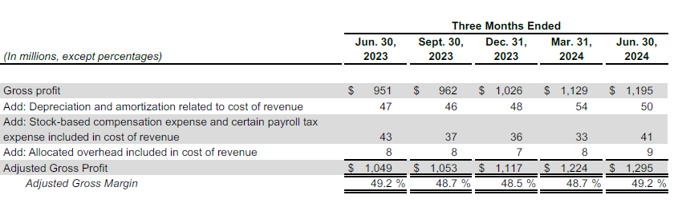
Compare Future Forecast Graph Data to Recently
Released Q2 2024 Financials
Released Values
Q2 2024
$1,350
The future forecast estimated a little more than the actual value
Notes:
Tuan: While we were working on the data, financial data was released for Q2 of 2024.
Therefore we can compare the forecast value against the actual.

Slide 13
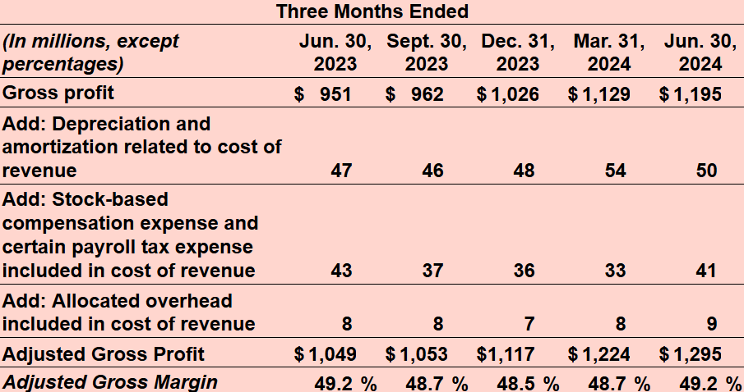
Compare Future Forecast Graph Data to Recently
Released Q2 2024 Financials
Released Values
Q2 2024
$1,350
The future forecast estimated a little more than the actual value
Snapshot of financials of each Quarter
Notes:
Tuan: While we were working on the data, financial data was released for Q2 of 2024.
Therefore we can compare the forecast value against the actual. About a 155 million difference.

Slide 14

Potential Next Steps
Link world events to specific time
Periods to find causes of fluctuations
2020 lock-down
Rise of competitors
Change of leadership
Provide feedback from previous setbacks and plan to counteract them
Yoda yoda
Notes:
Tuan: With this data collected, there are more information we can compare against to see why there are changes in the financials of DASH.
With this data analysis, DASH can improve their business practices or prepare for downturns.

Slide 15

Questions?

Slide 16


